Slide 1
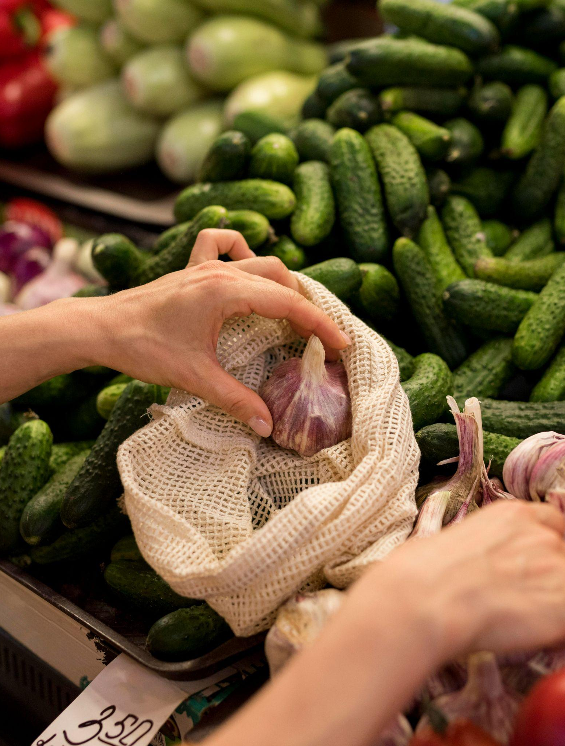
RAITU NESTHAM
TEAM - Spunk

Slide 2
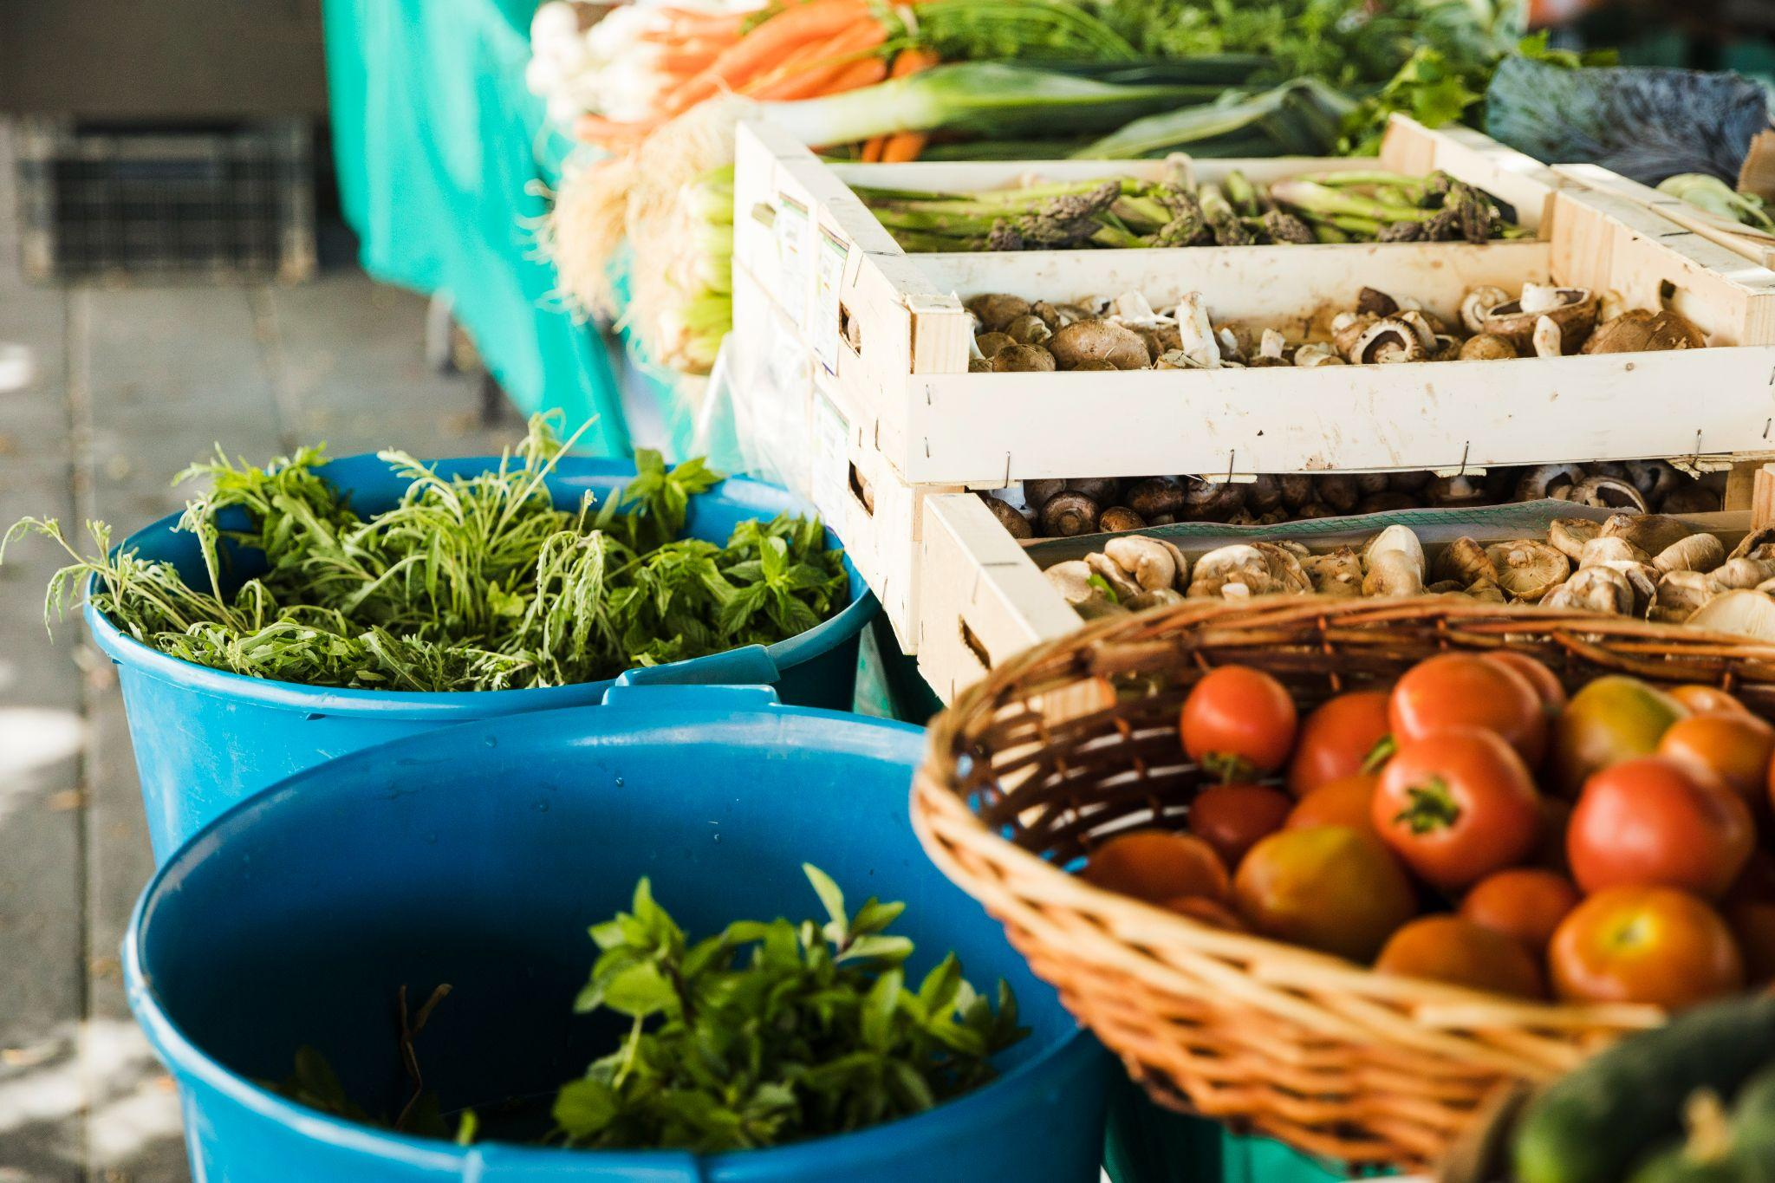
Problem statement
• Suggest plant types which can tolerate affecting weather and temperature changes.
• Identify the features of the crop and recommend the necessary measures to get a good yield.
• Predict approximate harvest time. • Predict the effects of climate change on different kinds of crops
• Predict further climate changes based on analyzed and previous data.

Slide 3
Table of contents
01
02
03
04
Implementation
Demonstration of Model
Innovativeness
Social Impact

Slide 4
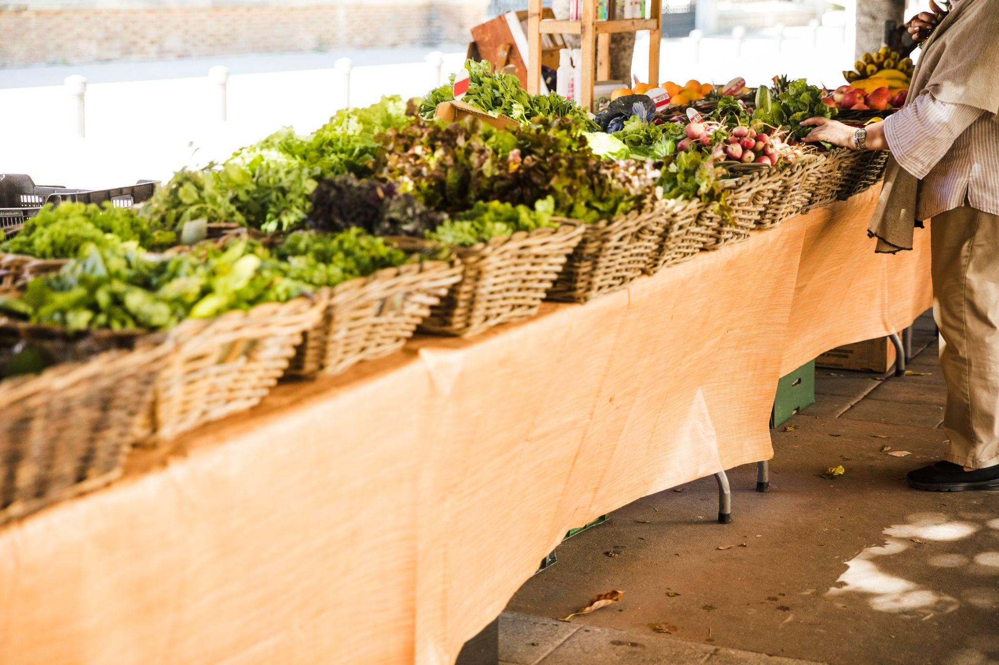
01
Implementation

Slide 5
INTRODUCTION
Our projects aim to bridge the gap between traditional agriculture and technology, providing farmers with AI-powered tools and cutting-edge insights.
Join us to discover how artificial intelligence can revolutionize agriculture related to crop production, such as weather forecasting, analyzing the characteristics of crops for good yields, predicting harvest time, assessing climate change and providing solutions for the future of agricultural planning.
Data collection and progress
We start by collecting a lot of data that is important to our AI farming. Data includes historical weather data, temperature data, climate change data, crop characteristics and yield data. Rigorous prioritization is essential to ensure accurate and valid data of machine learning models.

Slide 6
WORK FLOW
Data Collection and Preprocessing
Creation of Machine Learning Models
User Interface
Testing and Validation
Scalability and Sustainability
Future Enhancements

Slide 7
02
Demonstration of Model

Slide 8
MODELS
Model 1- CROP Feature Recognition Algorithm:
Convolutional Neural Network (CNN) CNN is used in image analysis to describe clipping features such as color, texture, and shape. The model learns from extensive image data to measure crop health and growth.
Model 2- Harvest Time Prediction:
Algorithm: Long Short-Term Memory (LSTM) Neural Network LSTM is used to predict the estimated harvest time by taking into account values ​​such as planting date, growth rate and needed wind cloud. Designed to protect continuous data and control time.
Model 3- Climate Change Impact Prediction:
Algorithm: Random Forest Random Forest is used to evaluate historical weather data and its impact on crops. Provides predictions of how climate change will affect various crops in the future.

Slide 9
Model 4- Crop Yield Prediction:
Algorithm: Random Forest Regression Features: Features include historical data, planting date, temperature, precipitation, soil pH, nutrient levels, and farming practices. Purpose: It is based on data entry.
Model 5- Fertilizer Recommendation:
Soil testing: Soil samples are collected and tested in a laboratory to determine nutrient levels. Data Preprocessing: Clean and generate soil, crop and climate data. Training model: Demonstrate the tree's decision-making model for the type of fertilizer and how much to distribute according to soil nutrient and crop variety.

Slide 10
03
Innovativeness

Slide 11
API’S
Integrating various APIs into your farming operation not only improves its operation, but also presents it in a new and holistic way. Here's how using these APIs can bring innovation and innovation to your projects:
Open Weather API:
What's New: Integration with the Open Weather API allows your system to access real-time weather and forecast data. This innovation is necessary to make product recommendations based on the current climate. Environment: Farmers can get up-to-date weather information to help them make timely decisions about planting, planting and protecting crops.
News API:
What's New: Integrating the News API provides meaningful context for your agriculture by providing news and updates about agriculture. Environment: Farmers and users can learn about new developments, models and best practices, facilitating continuous learning and adaptation in the practice farm.

Slide 12
Stripe API:
The integration of the Stripe API shows the project's progress towards monetization and utility. Impact: This innovation enables a subscription-based model, providing ongoing support to a project while at the same time allowing the project to reach a wider audience.
Open AI API:
Open AI API: What's New: The Open AI API integration adds a powerful AI-driven element to your project that can improve understanding and interaction of languages. Effect: Users can benefit from advanced chat bots or speech intelligence that make it easier for farmers to interact with and learn from your body.

Slide 13
04
Social Impact

Slide 14
Social Impact
Improving crops and food security:
By predicting the best planting and harvesting times and recommending suitable crops, your project can help increase people's agricultural output..
Improving Productivity: Fertilizer recommendations based on soil conditions can increase the efficiency of fertilizer use, reduce costs and have a positive impact for farmers. Using water efficiently, based on weather data, can help save water in agriculture.
Resilience to Climate Change: The ability to predict climate change and provide adaptation strategies can help agricultural communities increase their resilience to climate change wind and weather.
Access to Information: Farmers, especially in rural areas, often do not get timely and accurate information. By connecting these different data sources, your project can provide farmers with important weather, crop and agricultural information.
Financial computing: Your project integrating payments via the Stripe API can facilitate financial transactions for farmers with the ability to support accounting and access banking services today.

Slide 15
Tools and Technologies
1.Programming Languages:
PHP HTML CSS JavaScript
2. Web Server:
Apache (for hosting your web application)
3.Database:
SQL (for storing and managing data)
4.Machine Learning Libraries:
python (for implementing machine learning models) ,scikit-learn (for various machine learning tasks) PyTorch (for deep learning)
5.APIs:
Open Weather API (for accessing weather data)
News API (for delivering agriculture-related news and updates)
Stripe API (for payment processing and financial transactions)
Open AI API (for advanced AI interactions)

Slide 16
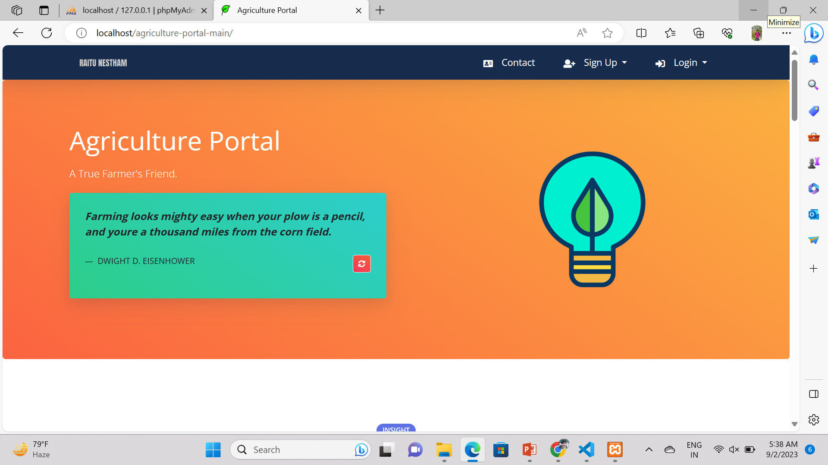
user experiences in your AI-powered agriculture project:
Homepage:
Purpose: The homepage is an entry point for users that provides details about the farm's work.
User Experience: Users are presented with a nice and intuitive face. From here they can access different features and pages including crop recommendations, yield forecasts, weather forecast, news updates and more.

Slide 17
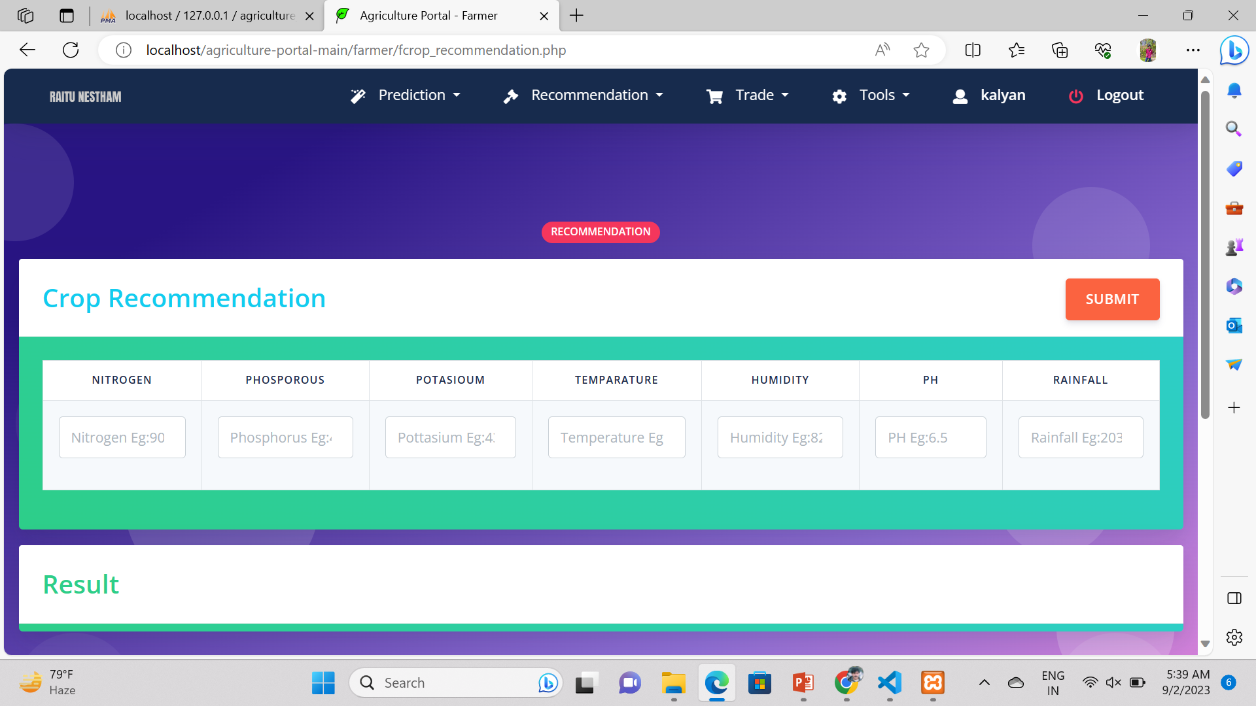
2. Crop Recommendation Page:
Purpose: This page provides farmers with recommendations for suitable crops based on current weather and soil information.
User Experience: Users can access their location, soil test results and other relevant information. The system then provides crop advice by understanding the suitability and expected yield of each proposed crop.

Slide 18
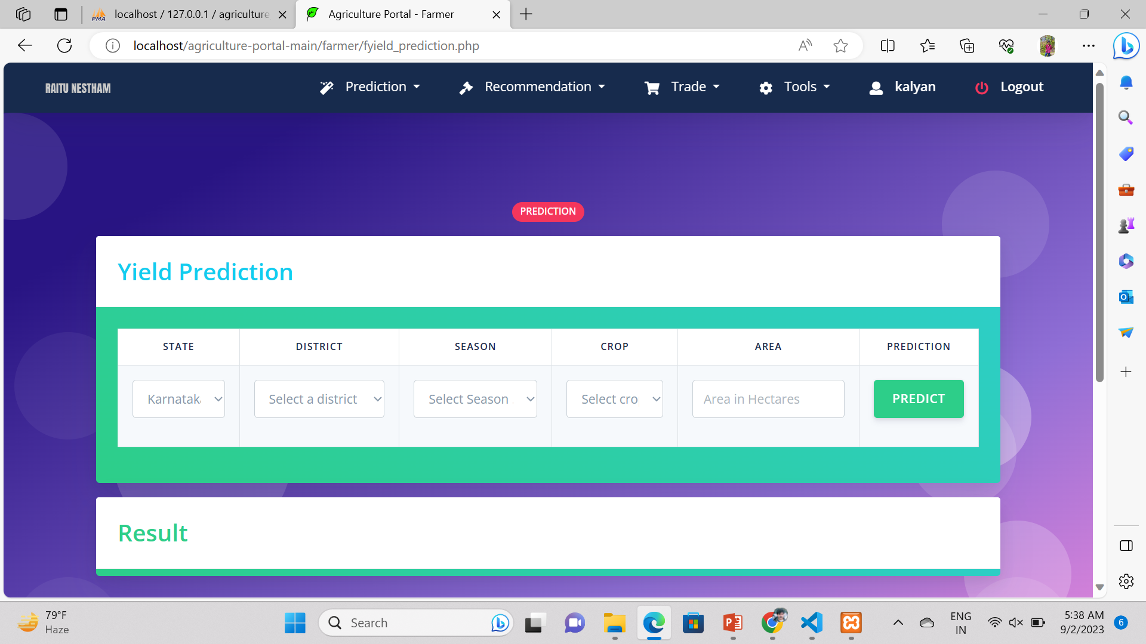
3. Yield Prediction Button:
Usage: The Yield Sheet helps farmers predict next season's crop yield.
User Experience: Farmers enter details such as crop type, planting date, soil and weather conditions. The system processes this information and provides an estimate of production needs. Users get better information to improve farming practices.

Slide 19
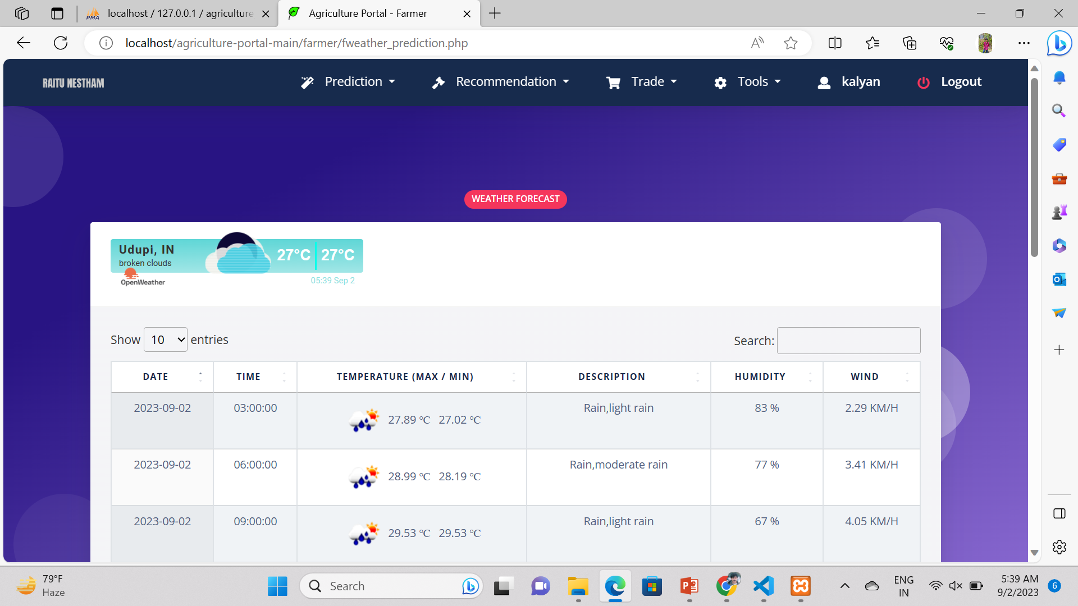
4. Weather Forecast page:
Purpose: This page provides real-time weather information and historical weather information.
User Experience: Users can search for their location or allow the system to access their current location. This page provides up-to-date weather, forecasts and climate information to help you make agricultural decisions..

Slide 20
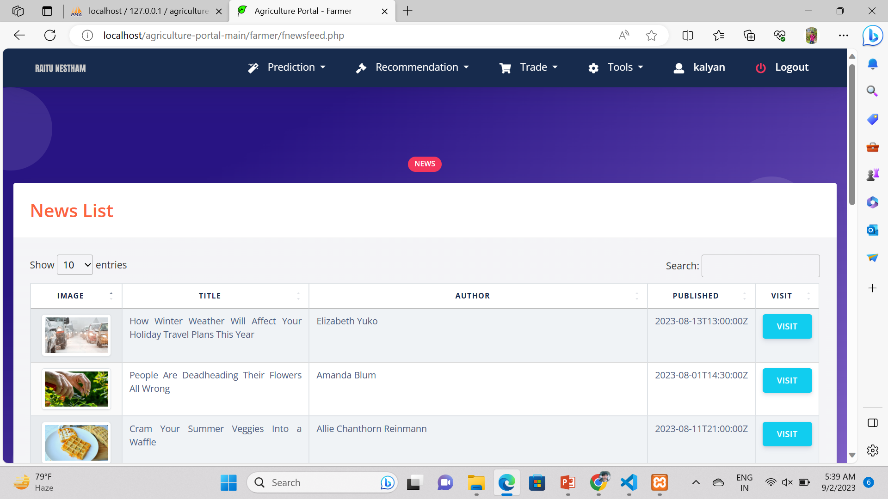
5. News Page:
Usage: The news page provides the latest agriculture news, trends and updates from trusted sources.
User Experience: Users can browse and filter news by category or relevance. The system collects relevant information and allows farmers to follow their business progress, helping them stay informed and make informed decisions.

Slide 21
CONCLUSION
Precision and Efficiency: Our project uses the power of intelligence and knowledge to deliver precise and timely ideas. From crop selection to harvest time, our technology optimizes agriculture for greater productivity.
Climate resilience: Climate change poses a threat to agriculture. By predicting climate impacts and adapting strategies, we empower farmers to reduce risk and succeed in the transition.
Information Access: We bring the latest weather news, agriculture news and insights at farmers' fingertips. Access to information is crucial to making informed decisions.
Financial Inclusion:: Our integration with Stripe creates opportunities for financial transactions, fosters economic inclusion in rural areas and fosters sustainable growth.
Social Impact: Our projects aim to create a positive impact on people as well as technology. We contribute to food security and the health of farming communities by improving products, management and productivity.

Slide 22
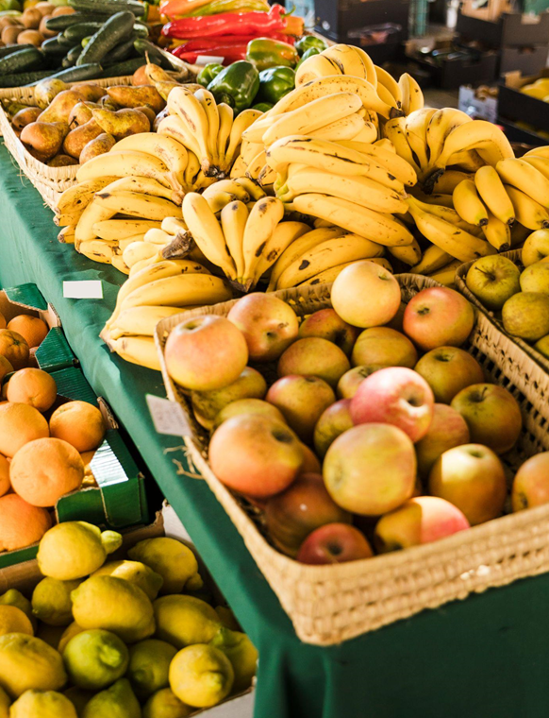
Thanks!

